Slide 1
PIPELINING
Pipelining is a technique of decomposing a sequential process into sub-operations, with each sub-process being executed in a segment that operates concurrently with all other segment.

Slide 2
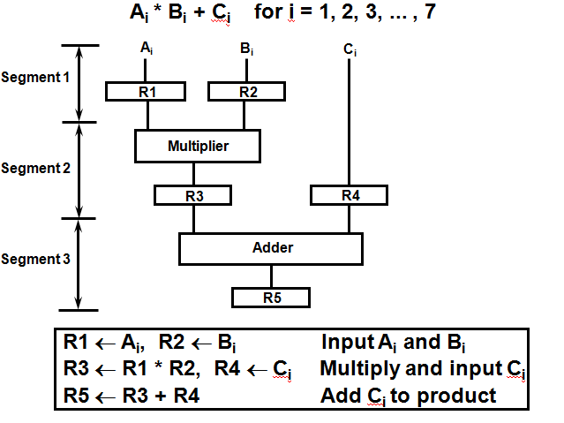
Example for Pipeline Processing

Slide 3
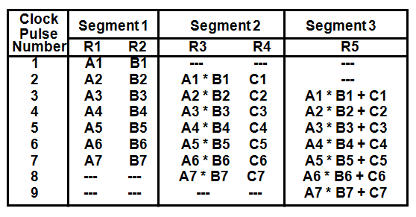
Operations in each pipeline stage

Slide 4
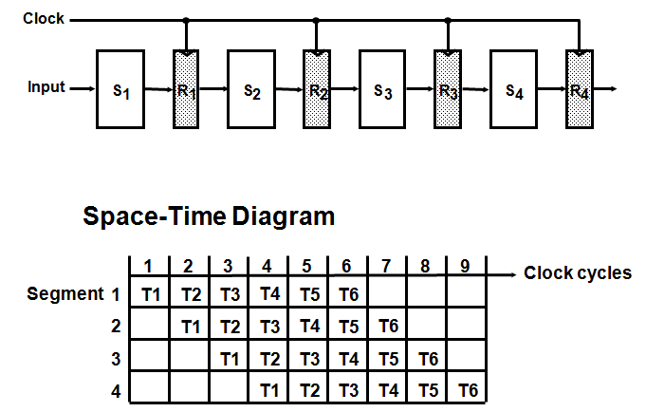
General Four-Segment Pipeline

Slide 5
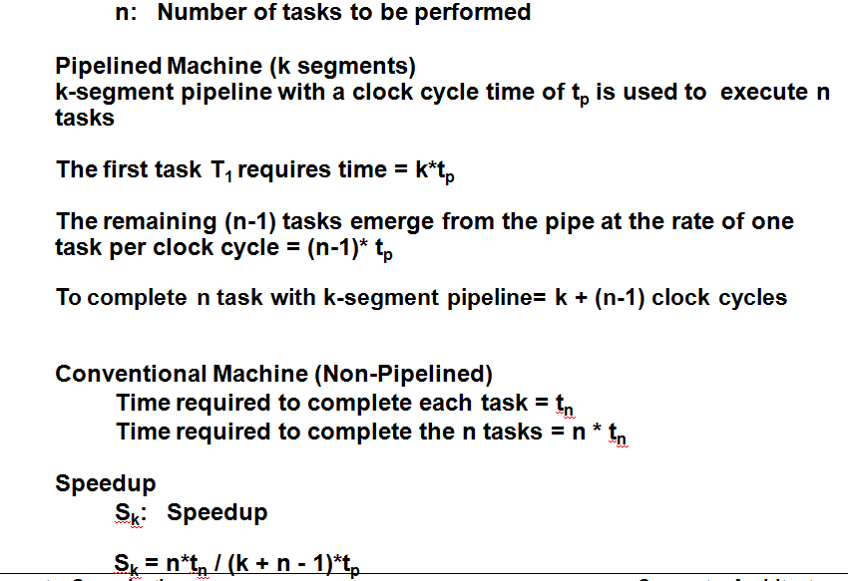
Pipeline Speedup

Slide 6
Q1. In certain scientific computation it is necessary to perform the arithmetic operation (Ai+Bi)*(Ci*Di)
Specify the pipeline configuration to carry out this task.
List the content of all registers of all the registers in the pipeline for i=1 to 6.
Q2. Draw a space time diagram for a six-segment pipeline showing the time it takes to process eight tasks.
Q3. A non-pipelined system takes 50ns to process a task. The same task can be processed in a six-segment pipeline with a clock cycle of 10ns. Determine the speedup ratio of the pipeline for 100 tasks.

Slide 7
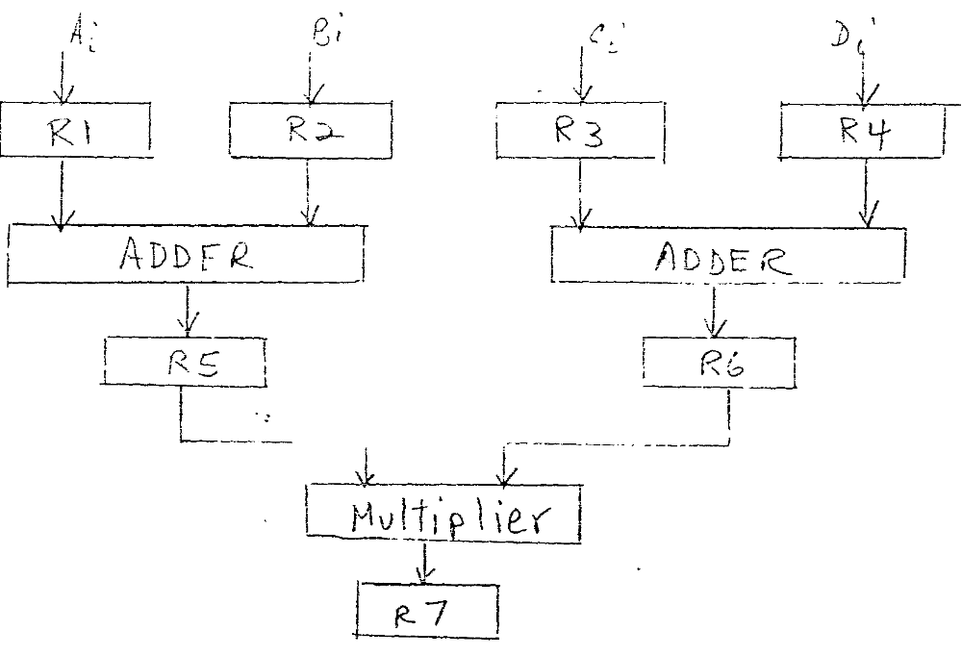

Slide 8
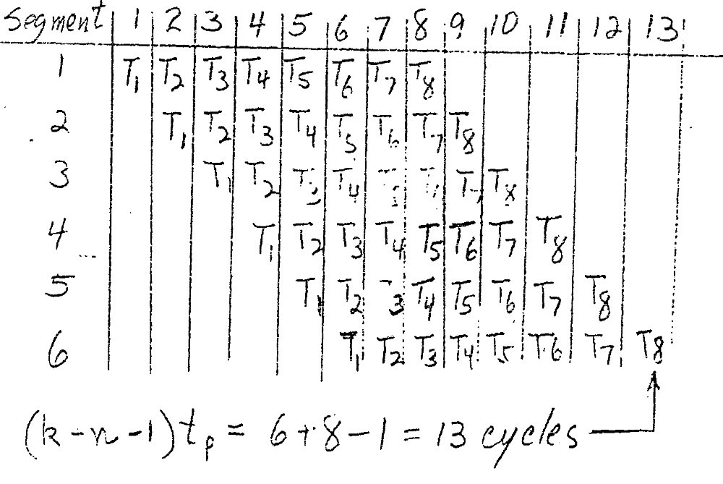

Slide 9
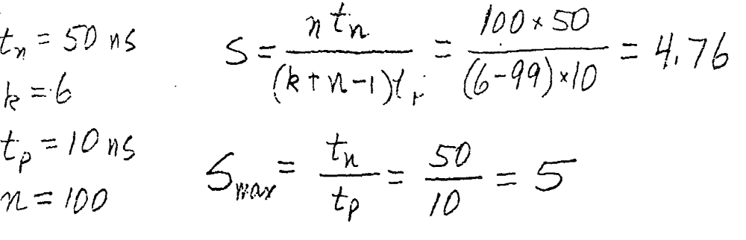

Slide 10
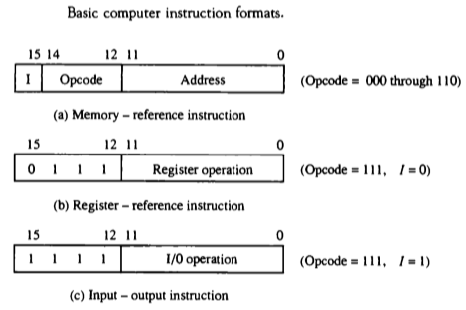
Computer Instructions
The basic computer has three instruction code formats.
Each format has 16 bits.
The operation code(op-code) part of the instruction contains three bits and the meaning of remaining 13 bits depends upon the op-code encountered.

Slide 11
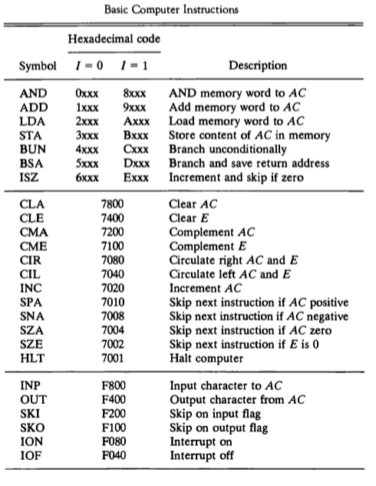
Computer Instruction Set

Slide 12
Instruction Cycle
The program is executed in the computer by going thru a cycle for each instruction.
In basic computer, each instruction cycle consists of the following phases:
Fetch an instruction from memory.
Decode the instruction.
Read the effective address from memory.
Execute the instruction.

Slide 13
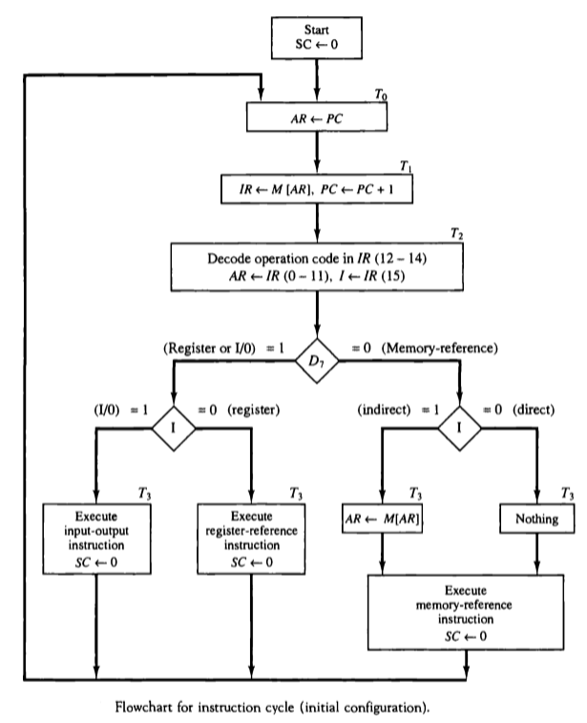
Instruction Cycle

Slide 14

Instruction Cycle
Micro-operations for fetch & decode

Slide 15
Data transfer between two registers:
Transfer the contents of R1 to R4.
Enable output of register R1 by setting R1_{out}=1. This places the contents of R1 on the processor bus.
Enable input of register R4 by setting R4_{in}=1. This loads the data from the processor bus into register R4.

Slide 16
Performing an Arithmetic or Logic Operation
The ALU is a combinational circuit that has no internal storage.
ALU gets the two operands from MUX and bus. The result is temporarily stored in register Z.
What is the sequence of operations to add the contents of register R1 to those of R2 and store the result in R3?
  R1_{out}, Y_{in}
  R2_{out}, Select Y, Add, Z_{in}
  Z_{out}, R3_{in}

Slide 17
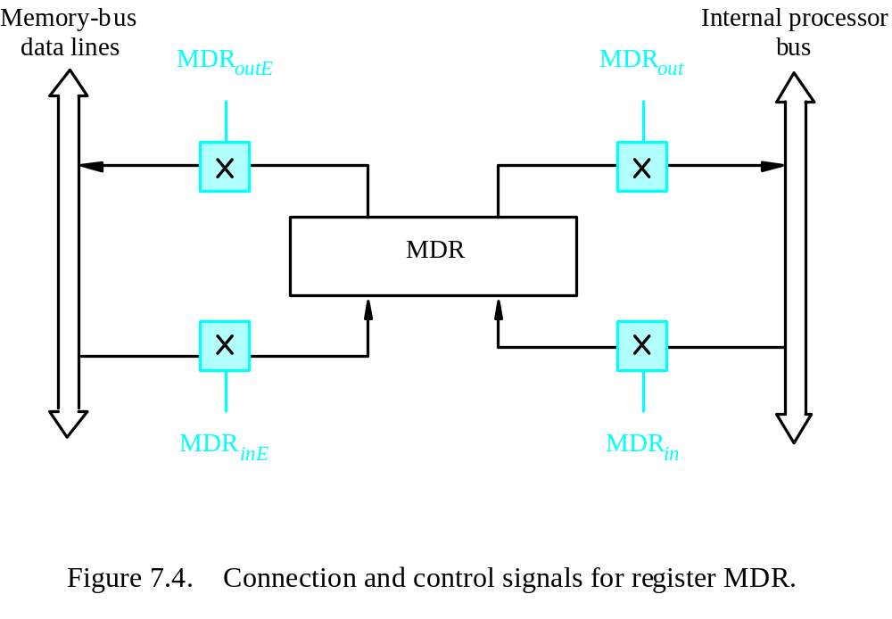
Fetching a Word from Memory
Address into MAR; issue Read operation; data into MDR.
Figure 7.4. Connection and control signals for register MDR.

Slide 18
Fetching a Word from Memory
The response time of each memory access varies (cache miss, memory-mapped I/O,…).
To accommodate this, the processor waits until it receives an indication that the requested operation has been completed (Memory-Function-Completed, MFC).
Example: Move (R1), R2
MAR ← [R1]
Start a Read operation on the memory bus
Wait for the MFC response from the memory
Load MDR from the memory bus
R2 ← [MDR]

Slide 19
Fetching a Word from Memory
Example: Move (R1), R2
MAR ← [R1]
Start a Read operation on the memory bus
Wait for the MFC response from the memory
Load MDR from the memory bus
R2 ← [MDR]
Assume MAR is always available on the address lines of the memory bus.
Move (R1), R2
R1_{out}, MAR_{in}, Read
MDR_{inE}, WMFC
MDR_{out}, R2_{in}

Slide 20
Storing a word in memory
Address is loaded into MAR
Data to be written loaded into MDR.
Write command is issued.
Example: Move R2,(R1)
R1_{out},MAR_{in}
R2_{out},MDR_{in},Write
  MDR_{outE}, WMFC

Slide 21
Execution of a Complete Instruction
Example: Add (R3), R1
Fetch the instruction
Fetch the first operand (the contents of the memory location pointed to by R3)
Perform the addition
Load the result into R1

Slide 22
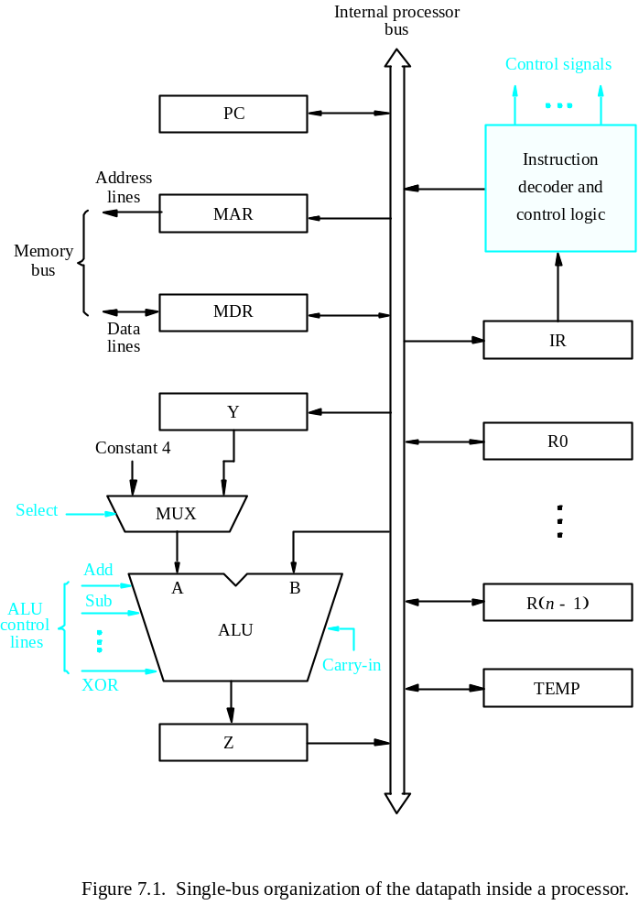
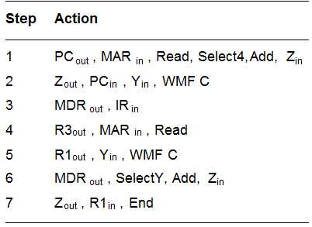
Execution of a Complete Instruction
Add (R3), R1

Slide 23
Micro-Operation
Computer system micro-operations are of four types:
  Register transfer micro-operations
  Arithmetic micro-operations
  Logic micro-operations
  Shift micro-operations

Slide 24
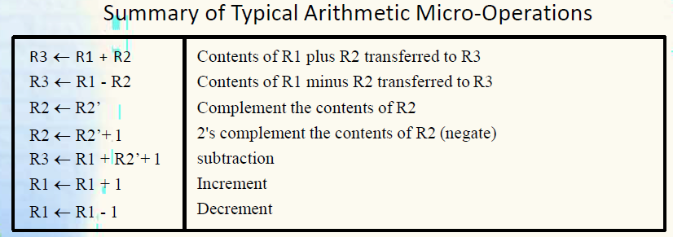
Arithmetic Micro-operations

Slide 25
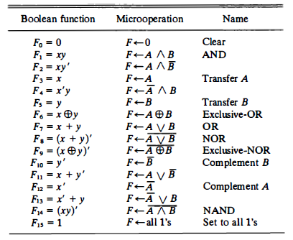
Logical Micro-operations

Slide 26
Shift Micro-operations
R ← shl R Shift-left register R
R ←shr R Shift-right register R
R ←cil R Circular shift-left register R
R ← cir R Circular shift-right register R
R ← ashl R Arithmetic shift-left R
R ← ashr R Arithmetic shift-right R

Slide 27
LOGICAL SHIFT
Shift Microoperations
In a logical shift the serial input to the shift is a 0.
A right logical shift operation:
A left logical shift operation:
In a Register Transfer Language, the following notation is used
  shl for a logical shift left
  shr for a logical shift right
0
0

Slide 28
CIRCULAR SHIFT
Shift Microoperations
In a circular shift the serial input is the bit that is shifted out of the other end of the register.
A right circular shift operation:
A left circular shift operation:
In a RTL, the following notation is used
  cil for a circular shift left
  cir for a circular shift right

Slide 29
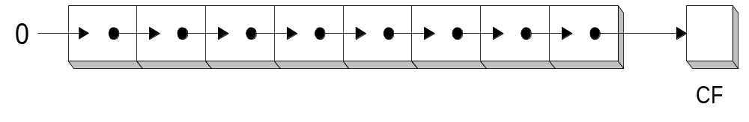
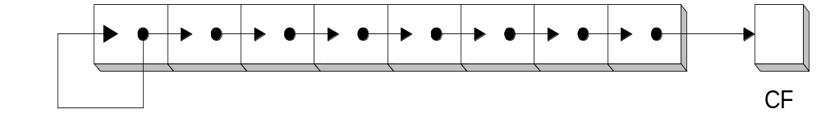
Logical versus Arithmetic Shift
A logical shift fills the newly created bit position with zero:
An arithmetic shift fills the newly created bit position with a copy of the number’s sign bit:
Arithmetic Right Shift Process

Slide 30
ARITHMETIC SHIFT
Shift Microoperations
An left arithmetic shift operation must be checked for the overflow
0
sign
bit
V
Before the shift, if the leftmost two bits differ, the shift will result in an overflow
In a RTL, the following notation is used
  ashl for an arithmetic shift left
  ashr for an arithmetic shift right

Slide 31
APPLICATIONS OF LOGIC MICROOPERATIONS
Logic Microoperations
Logic micro-operations can be used to manipulate individual bits or a portions of a word in a register.
Consider the data in a register A. In another register B is bit data that will be used to modify the contents of A.

Slide 32
SELECTIVE SET
Logic Microoperations
In a selective set operation, the bit pattern in B is used to set certain bits in A.
1 1 0 0 A
1 0 1 0 B (A ← A + B) OR Operation
1 1 1 0 A

Slide 33
SELECTIVE COMPLEMENT
Logic Microoperations
In a selective complement operation, the bit pattern in B is used to complement certain bits in A.
1 1 0 0 A
1 0 1 0 B (A ← A ⊕ B) XOR Operation
0 1 1 0 A

Slide 34
SELECTIVE CLEAR
Logic Microoperations
In a selective clear operation, the bit pattern in B is used to clear certain bits in A.
1 1 0 0 A
1 0 1 0 B (A ← A ⋅ B’)
0 1 0 0 A

Slide 35
MASK OPERATION
Logic Microoperations
The mask operation is similar to selective-clear operation except that the bits of A are cleared only where there are corresponding 0’s in B.
1 1 0 0 A
1 0 1 0 B (A ← A ⋅ B) AND Operation
1 0 0 0 A

Slide 36
INSERT OPERATION
Logic Microoperations
An insert operation inserts a new value into a group of bits. This is done by first masking the bits and then ORing them with the required value.
Example: A register contains eight bits 0110 1010. To replace the four leftmost bits by the value 1001, we first mask the four unwanted bits.
    0110 1010 A before
    0000 1111 B (mask)
    0000 1010 A after masking AND Operation
    And then insert the new value
    0000 1010 A before
    1001 0000 B (insert)
    1001 1010 A after insertion OR Operation

Slide 37
Question
Register A holds the 8-bit binary 11011001. Determine the B operation and the logic microoperation to be performed in order to change the value in A to : 01101101, 11111101

Slide 38
Basic Processing Unit

Slide 39
Fundamental Concepts
Processor fetches one instruction at a time and perform the operation specified.
Instructions are fetched from successive memory locations until a branch or a jump instruction is encountered.
Processor keeps track of the address of the memory location containing the next instruction to be fetched using Program Counter (PC).
Instruction Register (IR)

Slide 40
Executing an Instruction
Fetch the contents of the memory location pointed to by the PC. The contents of this location are loaded into the IR (fetch phase).
IR ← [[PC]]
Assuming that the memory is byte addressable, increment the contents of the PC by 4 (fetch phase).
PC ← [PC] + 4
(where each instruction comprises 4 bytes)
Carry out the actions specified by the instruction in the IR (execution phase).

Slide 41
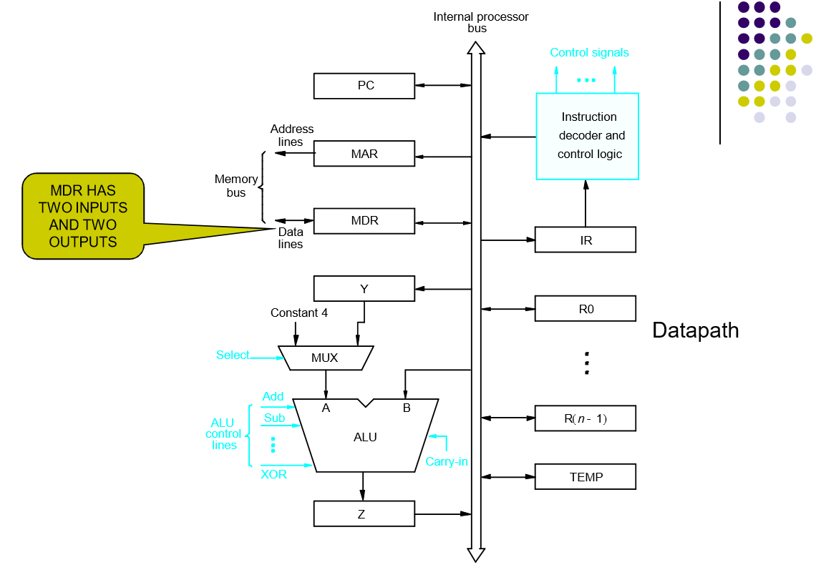
Processor Organization

Slide 42
Registers:
The processor registers R0 to Rn-1 vary considerably from one processor to another.
Registers are provided for general purpose used by programmer.
Registers Y, Z & TEMP are temporary registers used by processor during the execution of some instruction.
Multiplexer:
Select either the output of the register Y or a constant value 4 to be provided as input A of the ALU.
Constant 4 is used by the processor to increment the contents of PC.

Slide 43
ALU:
Used to perform arithmetic and logical operation.
Data Path:
The registers, ALU and interconnecting bus are collectively referred to as the data path.

Slide 44
Register Transfers
Internal processor
b
us
R
i
in
R
i
R
i
out
Y
in
Y
Constant 4
Select
MUX
A
B
ALU
Z
in
Z
Z
out
Figure 7.2. Input and output gating for the registers in Figure 7.1.

Slide 45
The input and output gates for register Ri are controlled by signals is R_{in} and R_{iout .}
If R_{in} is set to1 - data available on common bus are loaded into Ri.
If R_{iout} is set to1 - the contents of register are placed on the bus.
R_{iout} is set to 0 – the bus can be used for transferring data from other registers .

Slide 46
Data transfer between two registers:
Transfer the contents of R1 to R4.
Enable output of register R1 by setting R1_{out}=1. This places the contents of R1 on the processor bus.
Enable input of register R4 by setting R4_{in}=1. This loads the data from the processor bus into register R4.

Slide 47
Performing an Arithmetic or Logic Operation
The ALU is a combinational circuit that has no internal storage.
ALU gets the two operands from MUX and bus. The result is temporarily stored in register Z.
What is the sequence of operations to add the contents of register R1 to those of R2 and store the result in R3?
  R1_{out}, Y_{in}
  R2_{out}, Select Y, Add, Z_{in}
  Z_{out}, R3_{in}

Slide 48
Fetching a Word from Memory
Address into MAR; issue Read operation; data into MDR.
Figure 7.4. Connection and control signals for register MDR.

Slide 49
Fetching a Word from Memory
The response time of each memory access varies (cache miss, memory-mapped I/O,…).
To accommodate this, the processor waits until it receives an indication that the requested operation has been completed (Memory-Function-Completed, MFC).
Example: Move (R1), R2
MAR ← [R1]
Start a Read operation on the memory bus
Wait for the MFC response from the memory
Load MDR from the memory bus
R2 ← [MDR]

Slide 50
Fetching a Word from Memory
Example: Move (R1), R2
MAR ← [R1]
Start a Read operation on the memory bus
Wait for the MFC response from the memory
Load MDR from the memory bus
R2 ← [MDR]
Assume MAR is always available on the address lines of the memory bus.
Move (R1), R2
R1_{out}, MAR_{in}, Read
MDR_{inE}, WMFC
MDR_{out}, R2_{in}

Slide 51
Storing a word in memory
Address is loaded into MAR
Data to be written loaded into MDR.
Write command is issued.
Example: Move R2,(R1)
R1_{out},MAR_{in}
R2_{out},MDR_{in},Write
  MDR_{outE}, WMFC

Slide 52
Execution of a Complete Instruction
Example: Add (R3), R1
Fetch the instruction
Fetch the first operand (the contents of the memory location pointed to by R3)
Perform the addition
Load the result into R1

Slide 53
Execution of a Complete Instruction
Add (R3), R1

Slide 54
Question
Write the control sequence to execute
1. Add the (immediate) number NUM to register R1.
2. Add the contents of memory location NUM to register R1.
3. Add the contents of memory location whose address is at memory location NUM to register R1.

Slide 55
Solution 1
PC out, MAR in, Read, Select4, Add , Zin
Zout, PCin, Yin, WMFC
MDRout, IR in,
IR NUMout , Yin
R1 out, Select Y, Add, Zin
Zout, R1in, End

Slide 56
Solution 2
PC out, MAR in, Read, Select4, Add , Zin
Zout, PCin, Yin, WMFC
MDRout, IR in,
IRNUM out, MAR in, Read
R1out, Yin, WMFC
MDRout, Select Y, Add, Zin
Zout, R1in, End

Slide 57
Solution 3
PC out, MAR in, Read, Select4, Add , Zin
Zout, PCin, Yin, WMFC
MDRout, IR in
IRNUM out, MAR in, Read
WMFC
MDRout, MAR in, Read
R1out, Yin, WMFC
MDRout , SelectY, Add, Zin
Zout, R1in, End

Slide 58
Execution of Branch Instructions
A branch instruction replaces the contents of PC with the branch target address, which is usually obtained by adding an offset X given in the branch instruction.
The offset X is usually the difference between the branch target address and the address immediately following the branch instruction.
UnConditional branch

Slide 59
Execution of Branch Instructions
Step
Action
1
PC
out
,
MAR
in
,
Read,
Select4,
Add,
Z
in
2
Z
out
,
PC
in
,
Y
in
WMF
C
,
3
MDR
out
,
IR
in
4
Offset-field-of-IR
Select Y
out
,
,
Add,
Z
in
5
Z
out
,
PC
in
,
End
Figure 7.7. Control sequence for an unconditional branch instruction.

Slide 60
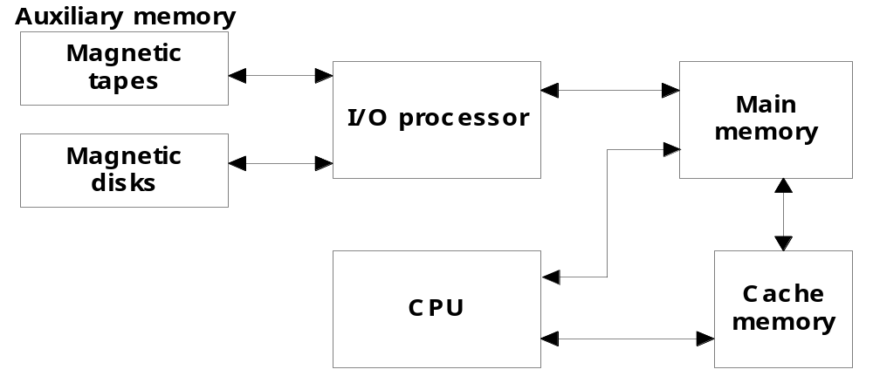
Memory Organization
Memory Hierarchy
  Memory hierarchy in a computer system :
    Main Memory : memory unit that communicates directly with the CPU (RAM)
    Auxiliary Memory : device that provide backup storage (Disk Drives)
    Cache Memory : special very-high-speed memory to increase the processing speed (Cache RAM)

Slide 61
Memory Organization
  Multiprogramming
    enable the CPU to process a number of independent program concurrently
  Memory Management System :
    supervise the flow of information between auxiliary memory and main memory
Register
Cache
Main Memory
Magnetic Disk
Magnetic Tape
Memory Hierarchy is to obtain the highest possible access speed while minimizing the total cost of the memory system

Slide 62
Random Access Memory (RAM)
  RAM Chips
  Static RAM
  Consists of Flip-flops to store binary information.
  Static RAM is easier to use and having short Read/Write cycles
  Used mostly in Cache memory.
  Dynamic RAM
  Stores binary information in the form of electric charge stored inside the capacitor.
  The capacitors are provided by MOS transistors.
  Refreshing circuit is required to refresh the memory.
  Dynamic RAM offers reduced power consumption and large storage capacity.
  It is used to construct main memory.
    Typical RAM chip :
      128 X 8 RAM : 2⁷ = 128 (7 bit address lines)
    Typical ROM chip:
      512 X 8 ROM : 2⁹ = 512 (9 bit address lines

Slide 63

Three State Buffer
Normal input A
Output Y=A if C=1
High-impedence if C=0
Control input C
Select
S₁
0
S₀
1
2×4 Decoder
A₀
2
Enable
E
3
B₀
C₀
Bus line with three-state buffer (replaces MUX0 in the previous diagram)
D₀

Slide 64
MAIN MEMORY
Main Memory
RAM and ROM Chips
Typical RAM chip
Chip select 1
CS1
Chip select 2
CS2
128 x 8
Read
RD
RAM
8-bit data bus
Write
WR
7-bit address
AD 7
CS1 CS2 RD WR
Memory function
State of data bus
0 0 x x
Inhibit
High-impedence
0 1 x x
Inhibit
High-impedence
1 0 0 0
Inhibit
High-impedence
1 0 0 1
Write
Input data to RAM
1 0 1 x
Read
Output data from RAM
1 1 x x
Inhibit
High-impedence
Typical ROM chip
Chip select 1
CS1
Chip select 2
CS2
512 x 8
8-bit data bus
ROM
9-bit address
AD 9

Slide 65
MEMORY ADDRESS MAP
Main Memory
Address space assignment to each memory chip
Example: 512 bytes RAM and 512 bytes ROM
Hexadecimal
address
Address bus
Component
10 9 8 7 6 5 4 3 2 1
RAM 1
RAM 2
RAM 3
RAM 4
ROM
0000 - 007F
0080 - 00FF
0100 - 017F
0180 - 01FF
0200 - 03FF
0 0 0 x x x x x x x
0 0 1 x x x x x x x
0 1 0 x x x x x x x
0 1 1 x x x x x x x
1 x x x x x x x x x
Memory Connection to CPU
- RAM and ROM chips are connected to a CPU
through the data and address buses
- The low-order lines in the address bus select
the byte within the chips and other lines in the
address bus select a particular chip through
its chip select inputs

Slide 66

CONNECTION OF MEMORY TO CPU
Main Memory
Address bus
CPU
16-11
10
9
8
7-1
RD
WR
Data bus
Decoder
3
2
1
0
CS1
CS2
128 x 8
Data
RD
RAM 1
WR
AD7
CS1
CS2
128 x 8
Data
RD
RAM 2
WR
AD7
CS1
CS2
128 x 8
Data
RD
RAM 3
WR
AD7
CS1
CS2
128 x 8
RD
RAM 4
Data
WR
AD7
CS1
1- 7
CS2
512 x 8
8
ROM
Data
9
AD9

Slide 67
Numerical Problems
Q1. a) How many 128x8 RAM chips are needed to provide a memory capacity of 2048 bytes.
b) How any lines of the address bus must be used to access 2048 bytes of memory. How many of these lines will be common to all chips.
c) How many lines must be decoded for chip select? Specify the size of decoders.
Q2. Extend the memory system of Fig.1 to 4096 bytes of RAM and 4096 bytes of RAM. List the memory-address map and indicate what size decoders are needed.
Q3. A computer employs RAM chips of 256x8 and ROM chips of 1024x8. The computer system needs 2K bytes of RAM, 4K bytes of ROM, and four interface units each with four registers. A memory-mapped I/O configuration used. The two highest-order bits of the address bus are assigned 00 for RAM, 01 for ROM, and 10 for interface registers.
How many RAM and ROM chips are needed.
Draw a memory-address map for the system.
Give the address range in hexadecimal for RAM, ROM and interface.

Slide 68
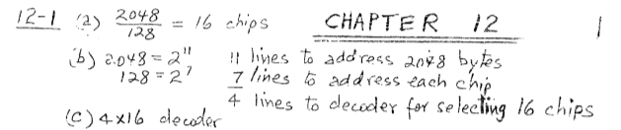
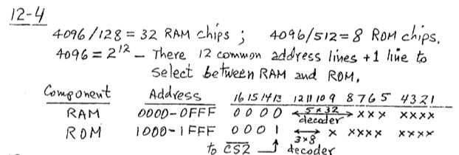

Slide 69
Cache Memory
12-5 Cache Memory
  Locality of Reference
    the references to memory tend to be confined within a few localized areas in memory
  Cache Memory : a fast small memory
    keeping the most frequently accessed instructions and data in the fast cache memory
  Hit Ratio
    the ratio of the number of hits divided by the total CPU references (hits + misses) to memory
      hit : the CPU finds the word in the cache
      miss : the word is not found in cache (CPU must read main memory)
  A computer with cache access time of 100ns, a main memory access time of 1000 ns, a hit ratio of 0.9 is having average access time of 200ns.

Slide 70
Types of Mapping of Cache Memory
  Mapping
    The transformation of data from main memory to cache memory
      1) Associative mapping
      2) Direct mapping
      3) Set-associative mapping
  Associative Mapping:
    main memory : 32 K x 12 bit word (15 bit address lines)
    cache memory : 512 x 12 bit word
      CPU sends a 15-bit address to cache
        Hit : CPU accepts the 12-bit data from cache
        Miss : CPU reads the data from main memory (then data is written to cache)

Slide 71
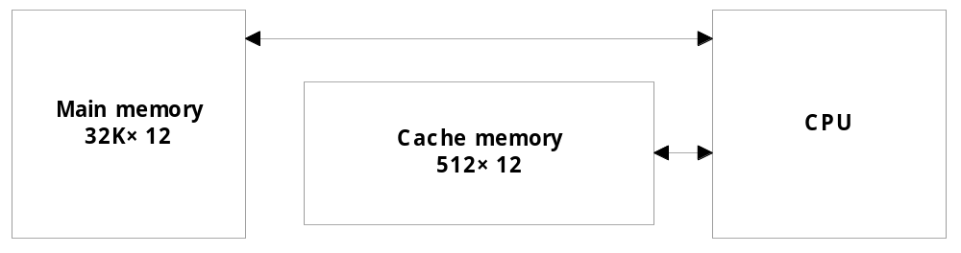
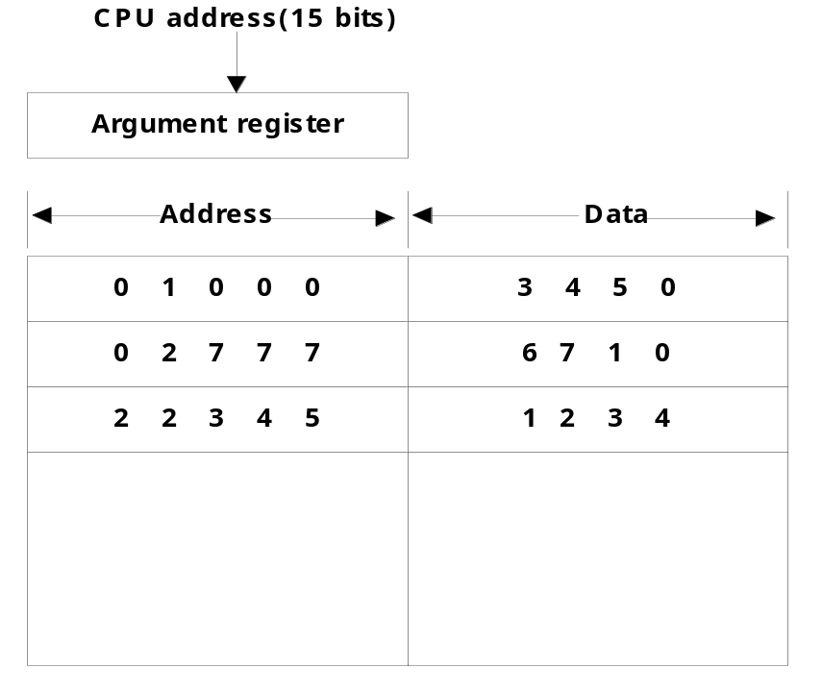
Associative Mapping

Slide 72
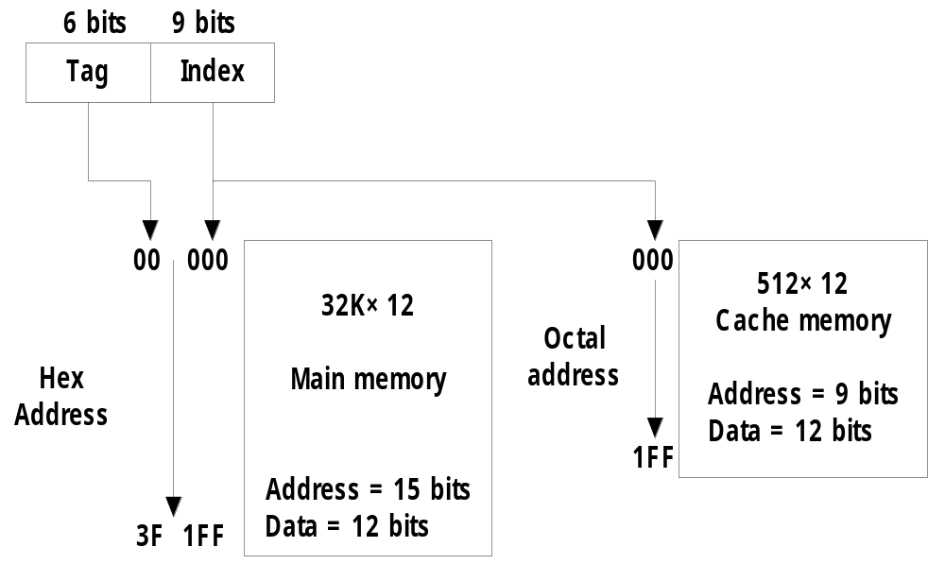
Direct Mapping
  Direct mapping :
    n bit memory address
    Tag field (n - k) : Index field (k)
    2^{k} words cache memory + 2^{n} words main memory
        Tag = 6 bit (15 - 9), Index = 9 bit

Slide 73
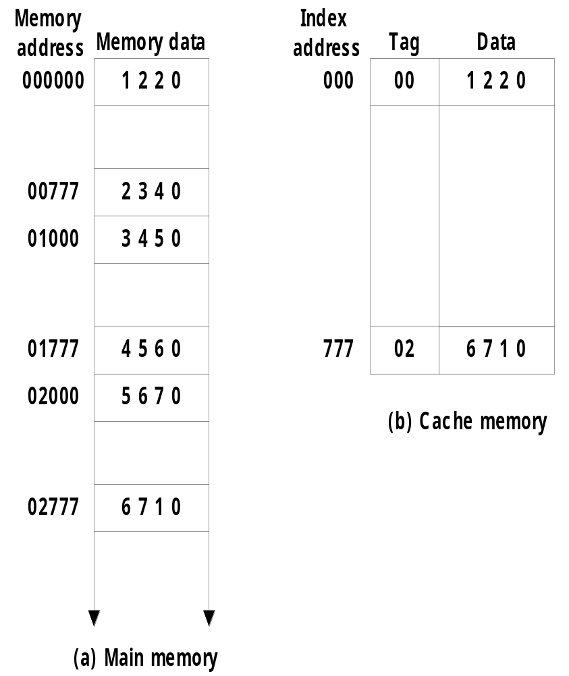
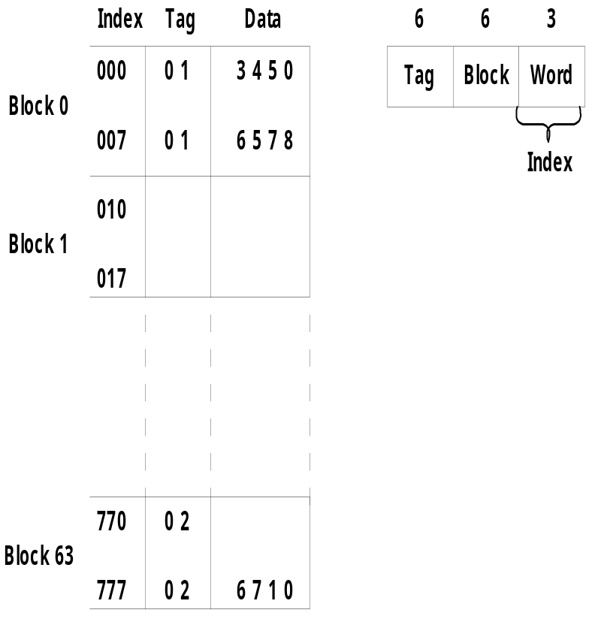
Direct Mapping
    Direct mapping cache with block size of 8 words :
      64 block x 8 word = 512 cache words size

Slide 74
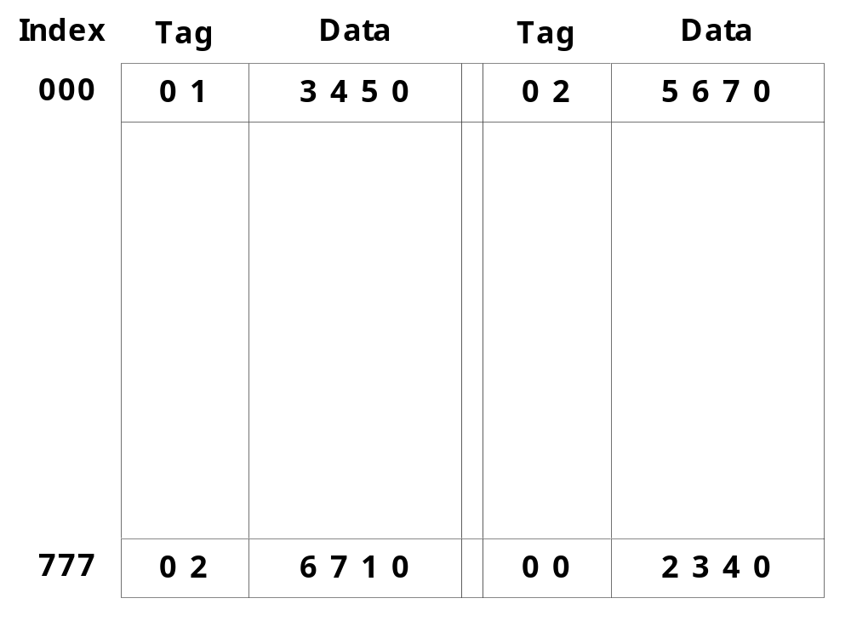
Set-Associative Mapping
  Set-associative mapping : (two-way)

Slide 75
Questions
A two-way set associative cache memory uses blocks of four words. The cache can accommodate a total of 2048 words from main memory. The main memory size is 128Kx32. Formulate all pertinent information required to construct the cache memory. What is the size of cache memory.
A computer has a memory unit of 64Kx16 and a cache memory of 1K words. The cache uses direct mapping with a block size of four words. How many bits are there in the tag, index, block, and words fields of the address format. How many bits are there in each word of cache, and how are they divided into functions? Include a valid bit. How many blocks can the cache accommodate?
The access time of a cache memory is 100ns and that of main memory is 1000ns. It is estimated that 80 percent of the memory requests are for read and the remaining 20 percent for write. The hit ratio for read access only is 0.9. A write-through procedure is used. What is the average access time of the system considering only memory read cycles. What is the average access time of the system for both read and write requests. What is the hit ratio considering the write requests also.

Slide 76
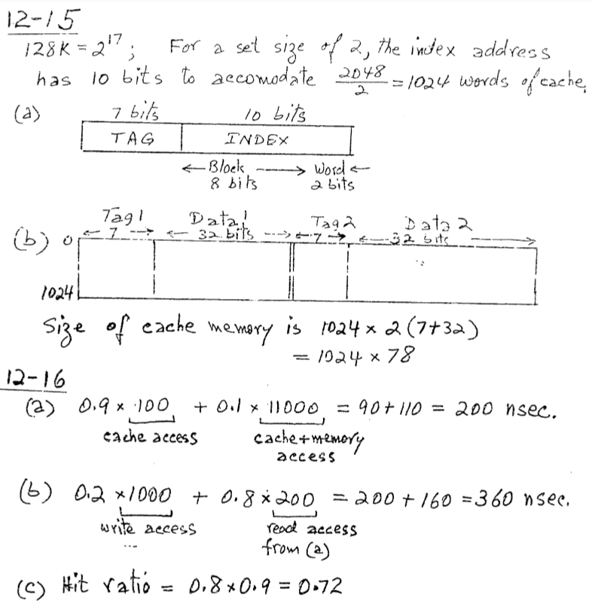
Answer

Slide 77
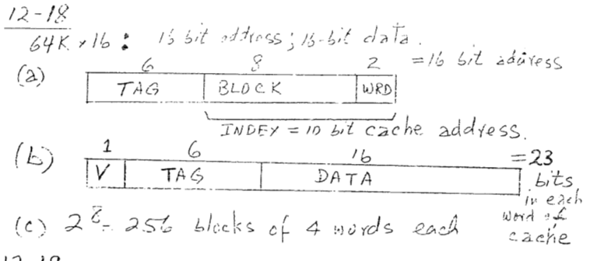
Answer

Slide 78
  Replacement Algorithm : cache miss or full
    1) LRU (Least Recently Used):
    2) Random Replacement:
    3) FIFO (First-In First-Out) :
  Writing to Cache :
      1) Write-through :
      2) Write-back :
  Cache Initialization
    Cache is initialized :
      1) When power is applied to the computer
      2) When main memory is loaded with a complete set of programs from auxiliary memory
      3) Cache is initialized by clearing all the valid bits to 0.
    Valid bit
      Indicate whether or not the word contains valid data

Slide 79
Virtual Memory
VIRTUAL MEMORY
Give the programmer the illusion that the system has a very large memory,
even though the computer actually has a relatively small main memory
Address Space(Logical) and Memory Space(Physical)
address space
memory space
virtual address
(logical address)
Mapping
physical address
address generated by programs actual main memory address

Slide 80
PAGE REPLACEMENT ALGORITHMS
Virtual Memory
FIFO
Reference string
7
0
1
2
0
3
0
4
2
3
0
3
2
1
2
0
1
7
0
1
7
7
7
2
2
2
4
4
4
0
0
0
7
7
7
0
0
0
3
3
3
2
2
2
1
1
1
0
0
1
1
1
0
0
0
3
3
3
2
2
2
1
Page frames
FIFO algorithm selects the page that has been in memory the longest time
Optimal Replacement (OPT) - Lowest page fault rate of all algorithms
Replace that page which will not be used for the longest period of time
Reference string
7
0
1
2
0
3
0
4
2
3
0
3
2
1
2
0
1
7
0
1
7
7
7
2
2
2
2
2
7
0
0
0
0
4
0
0
0
1
1
3
3
3
1
1
Page frames

Slide 81
PAGE REPLACEMENT ALGORITHMS
Virtual Memory
LRU
- OPT is difficult to implement since it requires future knowledge
Replace that page which has not been
used for the longest period of time
Reference string
7
0
1
2
0
3
0
4
2
3
0
3
2
1
2
0
1
7
0
1
7
7
7
2
2
4
4
4
0
1
1
1
0
0
0
0
0
0
3
3
3
0
0
1
1
3
3
2
2
2
2
2
7
Page frames

Slide 82
Question
The page request are in following order. If there are three memory frames, show the execution of the following pages using
a. FIFO b. Optimal c. LRU
6 0 1 3 2 5 0 4 7 1 3 2 6 0 4

Slide 83
Input-Output Organization
Peripheral Devices: Input & Output devices attached to computer are called Peripheral.
Input and output devices communicate alphanumeric information by using ASCII 7bit code.
To use computer efficiently, large number of programs and data must be prepared in advance for execution with computer.
I/O interface provides a method for transferring information between internal storage and external I/O devices.
    .

Slide 84
Input-Output Interface
The purpose of interfacing are as follows:
  Peripherals are electromechanical & electromagnetic devices and are interacting with electronics devices(CPU).
  Data transfer rate of peripherals is usually slower than transfer rate of CPU.
  Data codes and formats in peripherals differ from word format in CPU
  Operating modes of peripherals are different from each other and each one must be controlled without disturbing other.

Slide 85
Input-Output Interface
To resolve these differences, computer system includes Interface units between CPU and peripherals to supervise and synchronize all input and output transfers.
Each peripheral has its own controller that operates a particular electromechanical device.
To communicate with a particular device, the processor places a device address on the address lines.

Slide 86
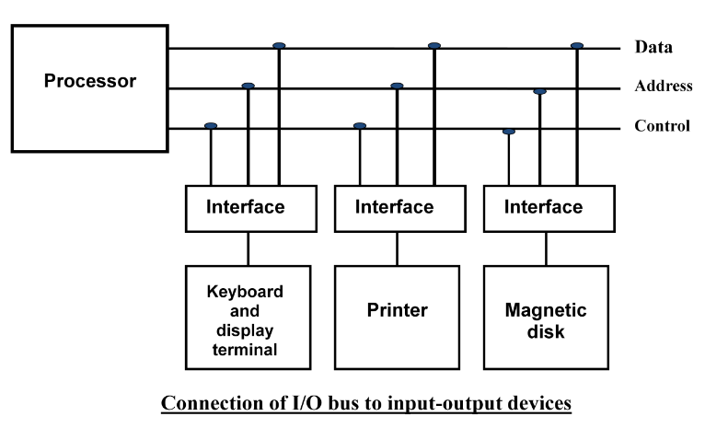
Input-Output Interface

Slide 87
Input-Output Interface
When the interface detects it own address, it activates path between bus lines and the device.
At the time address is made available in address lines, the processor provides function code(I/O command) in the control lines.
Types of I/O command:
Control command: To activate and inform what to do.
Status command: To test various status conditions.
Data Output data: It causes the transfer of data from bus into one of its registers.
Data Input Command: Interface receives data from peripheral and places them on buffer register where it is put into data lines.

Slide 88
I/O versus Memory Bus
In addition to communicating to I/O, processor must also communicate with memory unit.
There are three ways that computer buses can be used to communicate with memory and I/O:
  Use two separate buses, one for memory and one for I/O. (IOP)
  Use one common bus for both memory and I/O but have separate control lines for each. (Isolated I/O)
  Use one common bus for memory and I/O with common control lines. (Memory Mapped I/O)

Slide 89
Input-Output Transfer (IOP)
An IOP takes care of input and output tasks.
The CPU is assigned the task of initiating all operations, but I/O instructions are executed in IOP.
When an I/O operation is required, the CPU informs the IOP where to find the I/O program and then leaves the transfer details to the IOP.
IOP is also responsible of taking care of data synchronization, formats etc between CPU and I/O devices. In most computers CPU is master and IOP is slave.

Slide 90
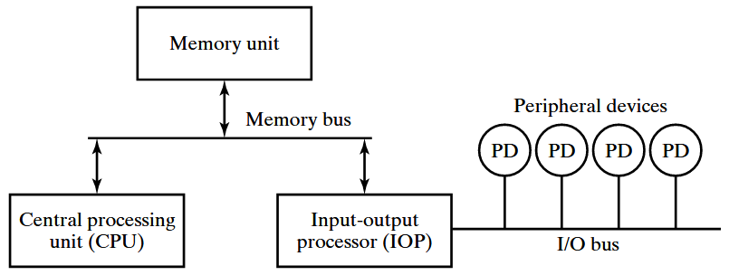
Input-Output Transfer (IOP)

Slide 91
Isolated I/O
The distinction between memory and I/O transfer is made through separate read and control lines.
I/O read and I/O write are enabled during I/O transfer and Memory read/write are enabled during memory transfer.
In the isolated I/O configuration, CPU have distinct input and output instructions where each of it will be associated with address of the interface register.
When the CPU fetches and decodes the I/O instruction, it places the address associated with the instruction on the common address lines and enables I/O read or I/O write control line.

Slide 92
Isolated I/O
When the CPU fetches and decodes the Memory instruction, it places the address associated with the instruction on the common address lines and enables Memory read or Memory write control line.
The isolated I/O method isolates memory and I/O addresses.

Slide 93
Memory Mapped I/O
In this configuration, same address space is used for both memory and I/O.
The computer treats interface register (I/O) as a part of memory system.
The assigned address cannot be used for storing memory words, which reduces memory address range available.
In a memory-mapped I/O organization, there are no specific, input or output instruction.
CPU manipulate I/O data residing in interface registers with the same instruction used to manipulate memory words.

Slide 94
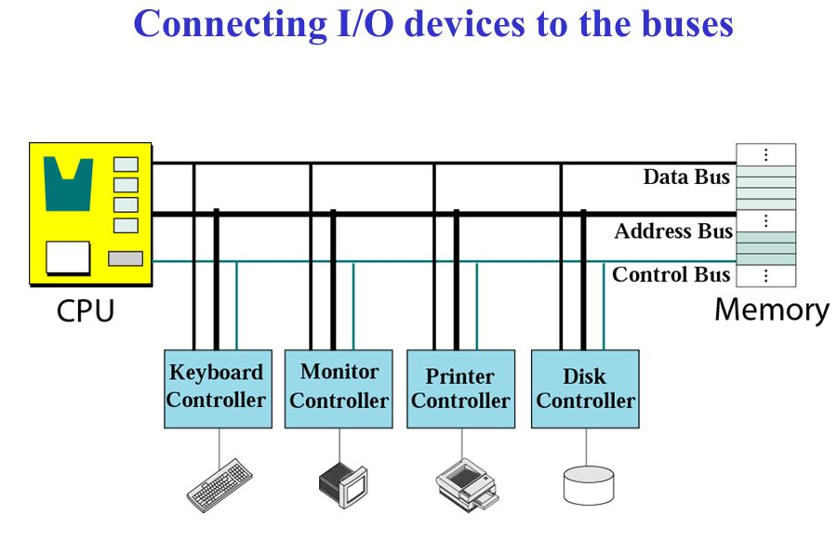
Memory Mapped I/O

Slide 95
Modes of Transfer
Data transfer between the CPU and the I/O devices may be handled in variety of modes. Some modes use the CPU as an intermediate path and others transfer the data directly to and from the memory unit.
Data transfer to and from peripherals may be handled in three ways:
  Programmed I/O
  Interrupt-initiated I/O
  Direct Memory Access (DMA)

Slide 96
Programmed I/O
Programmed I/O operations are the result of I/O instructions. Each data item transfer is initiate by an instruction in the program.
Usually the transfer is to and from a CPU register and peripheral. Other instructions are needed to transfer data between memory and CPU.
Once a data transfer is initiated, the CPU is required to monitor the interface to see when a transfer can again be made.

Slide 97
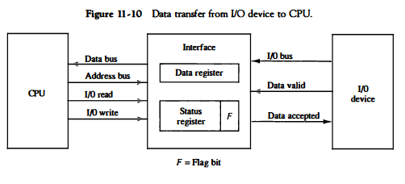
Programmed I/O

Slide 98
Interrupt Initiated I/O
In the programmed I/O CPU stays in program loop until the I/O indicates that it is ready for data transfer.
This is time consuming process since it makes CPU busy needlessly.
This can be avoided by using an interrupt facility.
When the interface determines that device is ready for data transfer, it generates an interrupt request.
Upon detecting external interrupt signal, the CPU momentarily stops the task it is processing.
It then branches to fulfill the I/O request and return to the original task.

Slide 99
Direct Memory Access (DMA)
The transfer of data between a fast storage device such as magnetic disk and memory often limited to the speed of CPU.
Removing the CPU and letting the peripheral device manage the memory bus directly improve speed of transfer.
Such transfer technique is called Direct Memory Access (DMA).
A DMA controller takes over the buses to manage the transfer directly between I/O device and memory.
During DMA transfer, the CPU is idle and has no control over memory buses.
By using Bus Request(BR) and Bus Grant(BG) the buses are released to DMA controller.

Slide 100
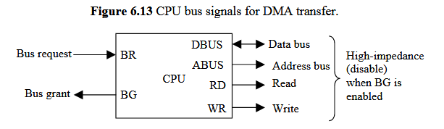
DMA
Data transfer ways:
  Burst Transfer: Here number of words are transferred in a block. Example: Magnetic disk.
  Cycle stealing: Allows the DMA controller to transfer one data word at a time after it must return the control of buses to CPU.

Slide 101
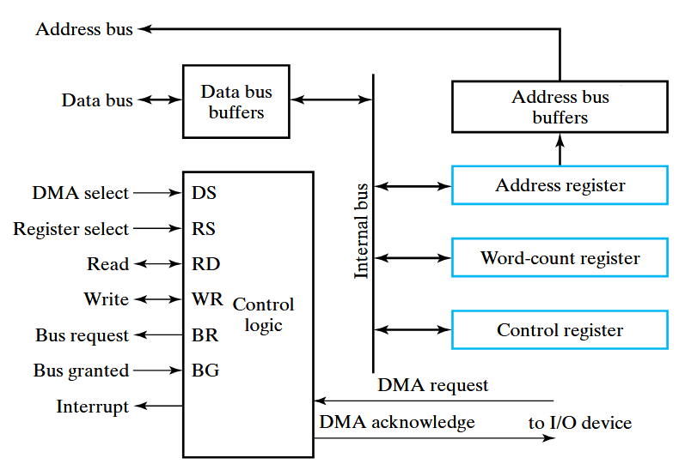
DMA Controller

Slide 102
Initialization of DMA
The CPU initializes the DMA by sending the following information through the data bus.
  The starting address of the memory block where data are available(for read) or where data are to be stored(for write).
  The word count, which is the number of words in the memory block.
  Control to specify the mode of transfer such as read or write.
  A control to start the DMA transfer.

Slide 103
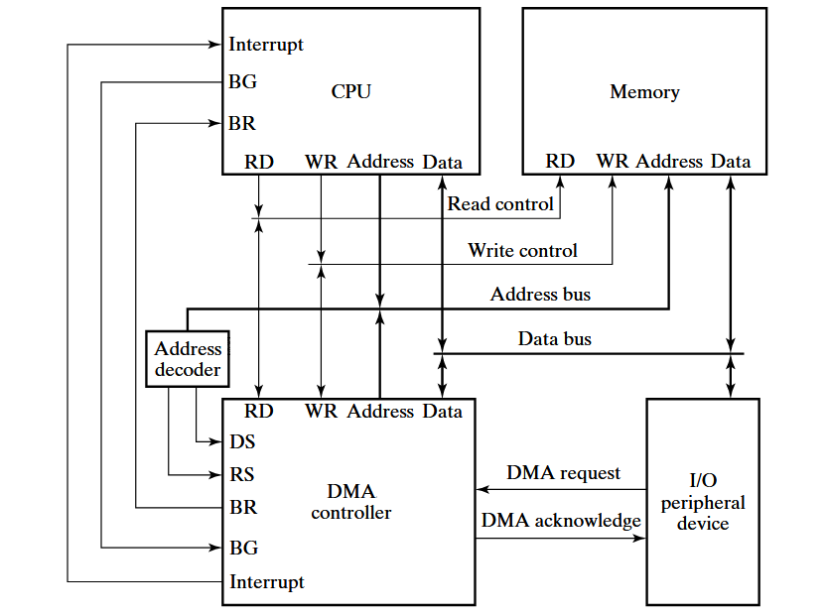
DMA Transfer in a computer system

Slide 104
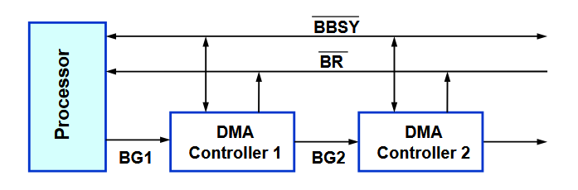
Bus Arbitration
The device that is allowed to initiate data transfers on the bus at any given time is called Bus master.
Bus arbitration is the process by which the next device becomes Bus master and will do the data transfer.
Two approaches: Centralized Arbitration and Distributed Arbitration.
        Centralized Arbitration

Slide 105
Types of Interrupt
Major types of Interrupt are:
  External Interrupt: It comes from I/O devices, from timing device, or from any other external source.
  Internal Interrupt: It includes register overflow, invalid operation code, stack overflow etc.
  Software Interrupt or Hardware Interrupt: External and Internal interrupts are initiated from signals that occur in the hardware of the CPU. A software interrupt is initiated by executing an instruction.
  Priority Interrupt: In case several sources will request service simultaneously, in this case system must decide which device to service first. For ex: Polling, Daisy Chain.

Slide 106
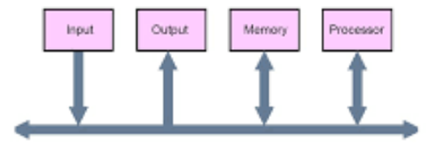
Buses
Data Bus: Bi-directional and transfers data.
Address Bus: Uni-directional and sends the address.
Control Bus: R/W, BR,BG etc.
Bus Structure: Single bus

Slide 107
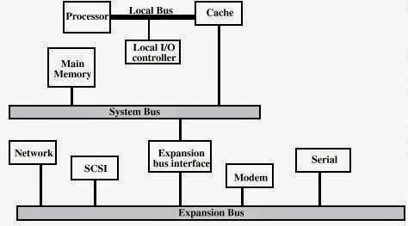
Buses
Bus Structure: Multi bus

Slide 108
Synchronous or Asynchronous Data Transfer
Internal operations in a digital system are synchronized by means of clock pulses supplied by common pulse generator.
If the registers in the interface share a common clock with the CPU registers, the transfer is synchronous.
Asynchronous data transfer requires that control signals be transmitted between communicating units to indicate the time at which data is being transmitted.
Asynchronous data transfer can be accomplished by Strobe & Handshaking.

Slide 109
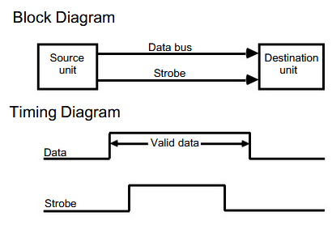
Strobe Control
Strobe control:
  It employs single control line.
  It can be activated either by source or destination unit.

Slide 110
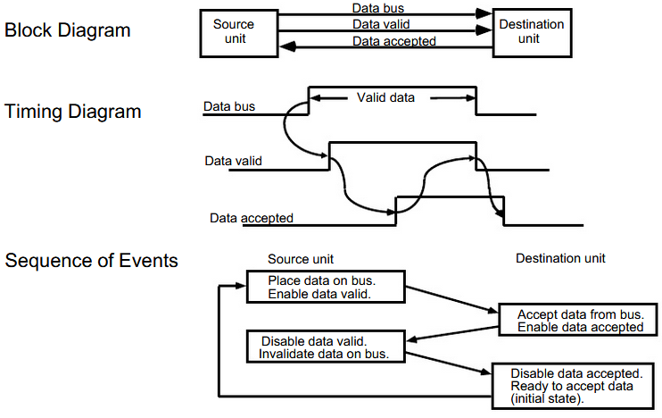
Handshaking

